Slide 1
Current situation and market drivers
B. Berg-Andersson, M. Kulvik, J. Kunttu, J. Lintunen, T. Orfanidou
EFI & ETLA Economic Research
Koli Forum Round Table – September 28, 2022

Slide 2
Current situation

Slide 3
Forest industries in the national economy
Pulp and paper industry is large in Finland, by value the most important exporting branch.
The major part of products are exported
Woodworking industry
Products are mostly used in construction or exported
Both industries use significant amounts of domestic intermediate inputs
Changes in forest industries’ production effects other branches, i.e., forestry, transportation, chemical and machinery industries

Slide 4
Trends: Forest industries’ production volumes

Slide 5
Trends: Export volumes since 1960

Slide 6
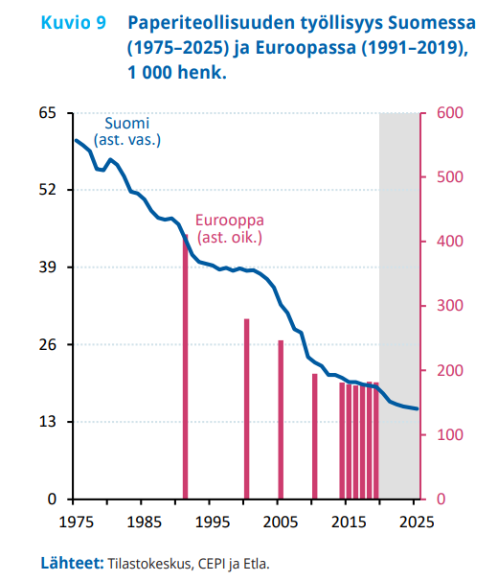
Trends
Employment in pulp and paper industry: Finland (blue line) and Europe (red bars)
Thousand
Thousand
Technological improvement, effective machines → employment has steadily declined
As a result, productivity has steadily increased
(def. productivity= value added/employment)
Note: also outsourcing from (maybe about) year 2000 onwards
Paper demand has decreased heavily, and demand of paperboard has increased → a worldwide shift in production towards paperboard
Enrichment of product portfolio:
Engineered wood products, textile fibers, liquid biofuels, biomedicals, etc.
Sources: Statistics Finland, CEPI, and Etla

Slide 7
Market factors – Short term
Forest industry strike in January-February 2020
UPM strike January-April 2022 affects industry production volumes a lot
Covid-19
2020 decrease in demand of especially graphical paper
Reductions in production following low demand and strike
2021 rebound (except paper), Stora Enso Veitsiluoto paper mill closed down
Forest recreation
Russian invasion of Ukraine
Wood imports from Russia stopped
Exports of paper industry products to Russia has fallen dramatically although no sanctions are imposed by EU
Energy crisis
Bioenergy up
Inflation

Slide 8
Increasing environmental regulation
LULUCF climate policy
No net emissions
Reference level
EU-wide target of LULUCF/AFOLU sink up to 2035
Biodiversity strategy
Strict protection
Nature restoration

Slide 9
Increasing environmental regulation
Renewable energy directive III
Forest bioenergy
Primary woody biomass (biomass from forests)
Secondary woody biomass (by-product biomass)
Cascading woody biomass use:
Wood products
Extending their service life
Re-use
Recycling
Bioenergy
Disposal

Slide 10
Forecast up to 2026

Slide 11
Pulp and paper industries 2022
UPM strike in early 2022 reduced exports of pulp and paper in the first half of the year
No EU sanctions are imposed on forest industry exports to Russia, but Finns have withdrawn voluntarily from Russia
Russian forest industry exports to EU have been stopped by sanctions
Paperboard exports have been increasing (volume +5 % in Jan-May), pulp -25 %, paper -53 % (Source: Finnish Forest Industries)
Export prices are higher than ever before (+30 % Y/Y in Jan-July)
In total, exports of the pulp and paper industry are declining about 13%, in volume terms, in 2022 as a result of the strike (-22 % in Jan-June)
Output declines 7%

Slide 12
Pulp and paper industries 2023-2026
Export prices are expected to decline from the current high levels
Export volumes will rebound in 2023 from the low level of 2022
After 2023, export volumes and output increase slowly, driven by paperboard and pulp
Value added reduces in 2022 and 2023 but increase slowly from 2024 onwards
In ETLA report no 112 ”The Finnish Forest Industries Up to Year 2025” it was calculated that employment will decrease on average by 3,1% per year during the period 2021-2025 (this part of the forecast not yet updated to 2026)
Productivity was expected to grow by 3% per year in 2023-2025

Slide 13
Woodworking industries 2022
The value of exports increased remarkably in 2021 (+55%), as export prices rose by 36%.
Also, the volume of exports grew strongly (+15%)
Demand has been higher than market supply, which has put upward pressure on prices
Export prices were all time high in June 2022, but turned downwards both in July and in August – on average export prices are still expected to be 25 % higher in 2022 compared to last year
The export volume is declining around 6 % this year from its high level in 2021, (-10% in Jan-June)
Output does not follow exports one-to-one
Construction keeps growing: 10% increase in wood product output

Slide 14
Woodworking industries 2023-2026
Export prices are expected to decline from the current high levels
After 2022, export volumes increase slowly
Output is expected to level out by 2025
Value added reduced very strongly in 2021, so it is expected to grow this year. On average in the years 2023-2026 value added will not grow.
Employment and growth in productivity is expected to remain relatively stable (Source: Etla report no. 112, this part of the forecast not yet updated)

Slide 15
Conclusions
Recent years have been full of surprises
Export prices have been all time high
Demand for domestic wood has been increased by the reduction in wood imports
Demand shocks such as the war in Ukraine or Covid-19 affect short term forecasts, which therefore need to be revised
Supply shocks such as strikes also induces a need to revise forecasts
In long term forecasts, temporary shocks do not affect the trends very much
Regulation can insert pressure on domestic wood supply in longer term

Slide 16
Thank you!

