Slide 1
ESRB High-Level Task Force on Safe Assets
Philip Lane (Chair)
Sam Langfield (Secretary)
Spyros Alogoskoufis (Assistant Secretary)

Slide 2
Safe Assets: Some Issues
  Sovereign bonds: benchmark assets
  Large stock; trading liquidity; common information base
  Collateral function in many market transactions
  Sovereign risk ?
  Multi-country monetary union; national-level fiscal liabilties (no joint mutualisation)
  Doom loop between domestic banking system and domestic sovereign

Slide 3
Background to the creation of the ESRB HLTF on Safe Assets
In June 2016, the ESRB GB established a HLTF
“to further investigate the empirical and practical considerations” related to sovereign bond-backed securities (SBBS)
SBBS represent an idea to create an area-wide low-risk asset without fiscal mutualisation
  Securities would be created by pooling and tranching cross-border portfolios of national sovereign bonds
Over past 18 months, HLTF has conducted analysis and gathered insights from market participants on feasibility of SBBS

Slide 4
HLTF’s technical contribution sheds light on SBBS
HLTF’s contribution is technical: sheds light on unique properties of SBBS and their potential role in enhancing financial stability
Two-volume report summarizes the HLTF’s findings:
  Volume I: 50 pages covers: motivation for SBBS; security design; market development; and regulation
  Volume II: 250 pages covers: risk measurement; contractual features; market intelligence; market liquidity; and a more detailed analysis of regulation
Report will be published shortly

Slide 5
HLTF’s main finding: there are regulatory barriers to SBBS
SBBS represent one interesting and attractive option for the design of an area-wide low-risk asset
Gradual development of a demand-led market for SBBS may be feasible under certain conditions
One necessary condition is for an SBBS-specific enabling regulation to reflect the unique design and risk properties of these securities
The level of investor demand for SBBS is an empirical question, which can only be tested with an SBBS-specific regulation that removes existing impediments

Slide 6
Regulatory Treatment of Sovereign Exposures (RTSE)
HLTF has not attempted to assess RTSE options: the focus was on SBBS, not RTSE
From the perspective of SBBS, it is clear that certain RTSE reform options would substantially enhance demand for the securities
This finding does not provide sufficient justification for embarking on RTSE reform, which should be evaluated on its own merits in other policy fora
The HLTF report acknowledges the differing policy positions of
HLTF members with respect to RTSE

Slide 7
Motivation for SBBS: financial stability and integration
SBBS could contribute to financial stability by supporting efforts to complete banking and capital markets unions
Reduce systemic risks by weakening the bank-sovereign nexus
  Combination of diversification and de-risking of bank sovereign bond portfolios
Reduce barriers to further financial integration
  SBBS could be used to collateralize area-wide transactions
  A mature SBBS market could provide an area-wide benchmark for asset pricing
But SBBS not a panacea: they stand alongside other policy initiatives to complete BU and CMU and deepen EMU

Slide 8
Basic security design reflects policy objectives
Security design is a policy choice:
  On asset side, designed to be area-wide
  On liability side, designed for senior to be low risk (based on Volume II simulations) and non-senior to be marketable (based on market intelligence)
A
L
Portfolio of euro-denominated central government bonds (based on capital key)
70% Senior
Tranching ⇒ seniority
Pooling ⇒ diversification
See Volume II
20% Mezz
10% Junior

Slide 9
Risk properties of SBBS: insights from default simulations

Slide 10
Risk properties of SBBS: insights from market data

Slide 11
How would SBBS be issued?
Each government still issues and services its own bonds
  SBBS arranger(s) buy some sovereign bonds on primary or secondary markets
  at market prices
  If a bond does not have a market price, it would not be included in the portfolio
SBBS arranger(s) could be private or public
  Private: Multiple arrangers would need to be regulated and supervised
  Public: Single arranger would require institutional framework to preclude perception of joint guarantees
SBBS issuers are bankruptcy-remote pass-through entities
  Issuers bear no risk on their own account: they receive portfolio directly from SBBS arranger(s), and pass cash flows to SBBS investors according to seniority

Slide 12
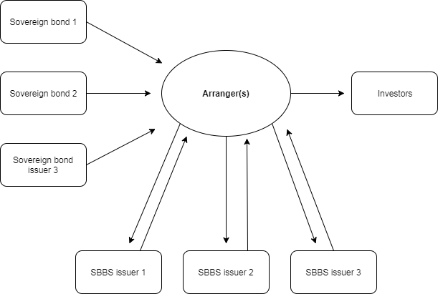
Generic SBBS issuance model

Slide 13
Incremental development of an SBBS market
SBBS issuance would be demand-led
  Issued only insofar as there is investor demand for the three securities
SBBS market would develop gradually
  Early phase: Similar to ESM bond market development
  Transitional phase: Market grows gradually (e.g. to €1.5tn), conditional on
  smooth market functioning
Market size can be controlled by policymakers
  Unintended side-effects can be managed by rationing the issuance of
  “SBBS license numbers”

Slide 14
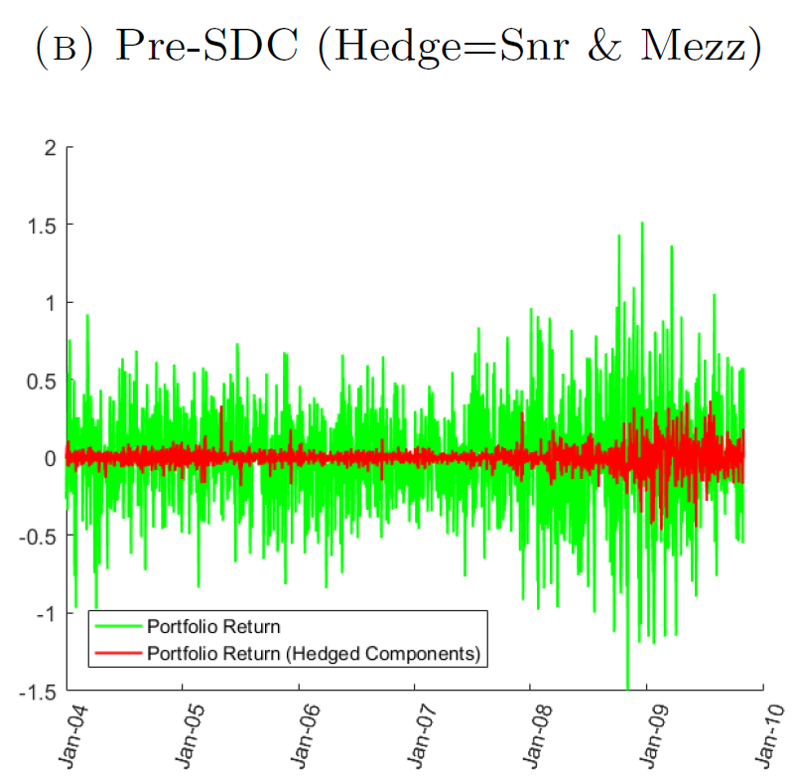
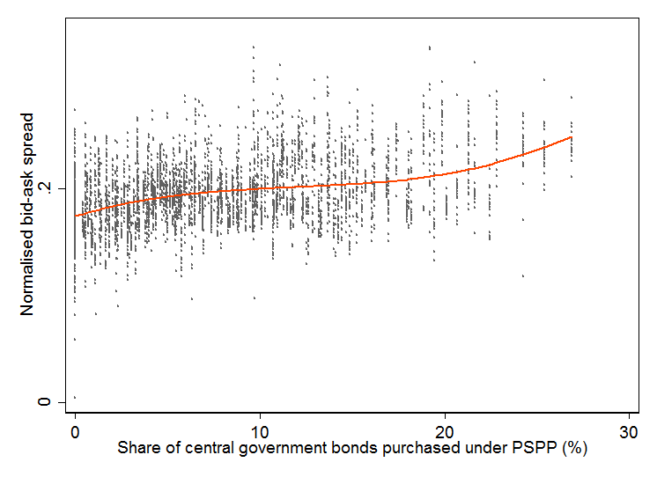
Ambiguous effects on sovereign bond market liquidity
  Freezing effect (-ve):
  Sovereign bonds frozen on
  SBBS issuers’ balance sheets
Spillover effect (+ve):
Liquid SBBS could be used
to reduce hedging costs

Slide 15
Investment-enhancing effect from non-euro investors
Holdings of government bonds
Holdings of supranational bonds

Slide 16
Regulation: necessary to remove existing barriers
At present, SBBS receive unfavourable regulatory treatment
  Sufficient reason why the securities have not yet been created by markets
One necessary condition for market creation is to treat SBBS
in line with their unique design and risk properties
  Senior SBBS: Analysis in Volume II suggests that they should be treated
  no more severely than sovereign bonds
  Non-senior SBBS: Treatment should reflect their greater riskiness
An enabling SBBS-specific product regulation could remove existing barriers by providing a new treatment for all sectors

Slide 17
Conclusion and next steps
SBBS represent one interesting and attractive option for the design of an area-wide low-risk asset
Gradual development of a demand-led market for SBBS may be feasible under certain conditions
Necessary to remove regulatory barriers to market development
Next step: publish report to better inform policy discussions
  Past contributions from market participants are expected to be revised
  as report brings to light new information

