Slide 1
NOU 2015: 8 The Future of schooling
Renewal of subjects and competences

Slide 2
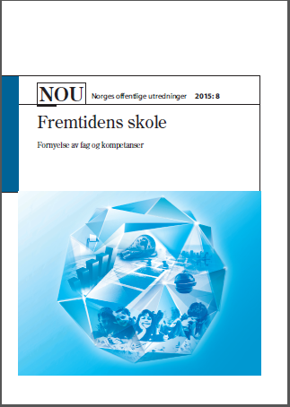

Slide 3
Key questions in the report
Which competences will become important for the students in their school activities, in further education and work life, and as responsible citizens?
Which changes are needed in the subjects in order for the students to be able to develop these competences?
What are the demands for different institutions and actors in the educational system to insure that subject renewal will lead to in-depth learning?

Slide 4
Building evidence for learning
What types of evidence?
Evidence at different levels – research designs and generalizations
Evidence in microstructures and interactions
Measurement, processes, abstraction - and the context
Aggregation and transformation of practices
Knowledge organizing
Differences:
Abstracting; sorting key factors
Integrated in sequences actions

Slide 5
Using evidence for change
What works – what is what and what does work means?
1=1
Limitation – the boundaries
The move from empirical results to normative assumption as guidelines
What should we not do – from single studies to policy or systemic changes

Slide 6
Future learning
Connecting multiple resources
Interpretation of data (visual, figures, tables etc.)
Scientific methods and ways of reasoning
Critical thinking and reasoning and ethical considerations
Problem solving in digital environments
Knowledge integration as condition for becoming a involved and participating citizen
In-depth learning and learning progression

Slide 7
The need for subject renewal
Deep trends in the society
The knowledge foundation
The objects clause for the Norwegian school system

Slide 8
Learning metaphors

Slide 10
Multiplicity – students perspetices

Slide 11
Learning metaphors - Distributed cognition

Slide 12
Curriculum overload
Curriculum «A mile wide and an inch deep» (Smith et al., 1996, s. 68)
Information overload
Inquiry takes to much time
Experiment is relevant, but one can’t be sure if the experiences become transformed to concepts
Forms of assessment

Slide 13
Building blocks in the subject curriculum
Curriculum overload
Increased weight on building blocks in the construction of the subject curriculum
Methods, ways of reason, concepts and conceptual systems principles and contexts

Slide 14
Design based research
Designing for in-depth orientation
Hard-to-learn problems
Generative ideas and principles
Over several weeks

Slide 15
What can time mean for learning concepts – within a conceptual systems
Problem: Overload with regards to themes – and relation between themes (prior knowledge, connecting, transfer ….)
Natural science
US 65 themes grade 8
Japan 5 themes grade 8
Norge – closer to the US than Japan

Slide 16
Deep versus surface
Design (M. Linn et al)
13 weeks
10 weeks
8 weeks
6 weeks
Recommmendation 1-2 weeks
3000 students – multiple choice, knowledge integration items and qualitative methods

Slide 17
Theme: thermodynamic
Insulation, conduction and heat flow
Heat, energy and temperature
Thermal equilibrium

Slide 18
Deep versus surface

Slide 19
Deep versus surface Heat, energy and temperature

Slide 20
Deep versus surface Insulation, conduction and heat flow

Slide 21
Deep versus surface
Summary
Study of one student
12 weeks
’Thermodynamics’ – 70-90% of the students develops normative ideas within the themes
Reduction of time with 50% then the reduction goes down…..
To develop good normative understanding – approx. 8 weeks
Students patterns can continue …. Transfer

Slide 22
In-depth learning and progression
Robust and flexible understanding
Transfer to new situations and settings
Understanding of relationship between concepts and how to use them
Reflections over the learning processes and outcomes
Development over time – learning trajectories

Slide 23
In-depth learning and progression
In-depth learning
Cognitive dimension
Self-regulation
Dialogues – advanced talk
Validation of arguments in different knowledge domains
Generic and domain specific competences

Slide 24
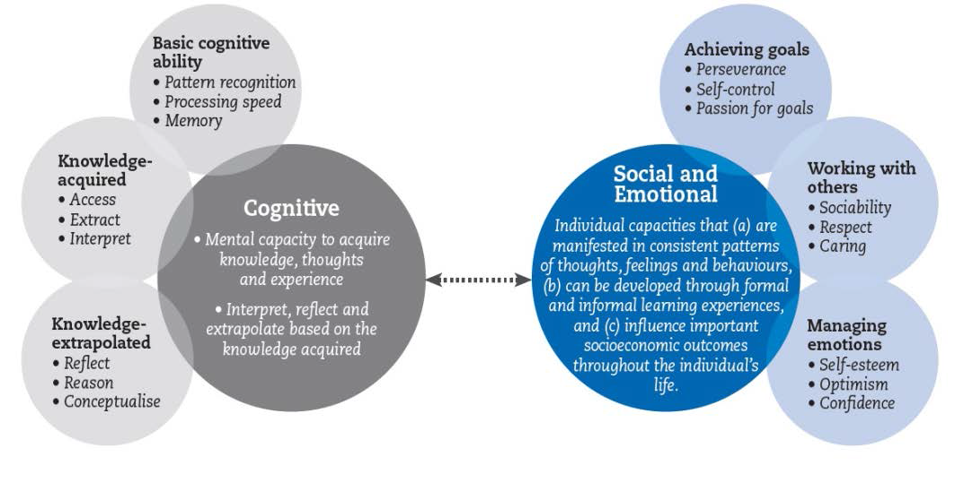
Framework for social, emotional and cognitive competences (source, OECD 2015)

Slide 25
A broad concept of competence
Involves solving problems and dealing with challenges in different context, including cognitive, practical, social and emotional aspects of pupils`s learning

Slide 26
Subject renewal
Four areas of competences
In-depth learning and learning progression
Building blocks in the subjects
Cross curriculum themes:
Multicultural society, sustainable development and health and well-being

Slide 27
How to create change?
Implementation strategy – “all” institutions and actors engaged and involved
Increased focus on curriculum development and developmental work for municipalities and schools
Development of competences and capacity building
Research-based knowledge as foundation for further development

Slide 28
Four areas of competences
Competences in the subjects/knowledge domains
Mathematics, science and technology
Languages
Social science and ethics
Art, design, craft, music, physical education, health and nutrition
Competences to learn – generic and domain specific
metacognition and self regulation
To communicate, collaborate and participate – generic and domain specific
Competences in reading, writing and oral communication
Collaboration, participation and democratic competences
Digital competences
To explore, inquire, create –generic and domain specific
Creativity and innovation
Critical thinking and problem solving

Slide 29
The Committee
Professor Sten Ludvigsen, head of the committee
Chief municipal education officer Eli Gundersen
Journalist Sigve Indregard
Dr.med. Bushra Ishaq
Chairman Kjersti Kleven
Principal Tormod Korpås
Professor Jens Rasmussen
Professor Mari Rege
Phd-student Sunniva Rose
Professor Daniel Sundberg
Project manager Helge Øye

