Slide 1
Geoeconomy and economic affairs policy
Jyrki Ali-Yrkkö and Tero Kuusi

Slide 2
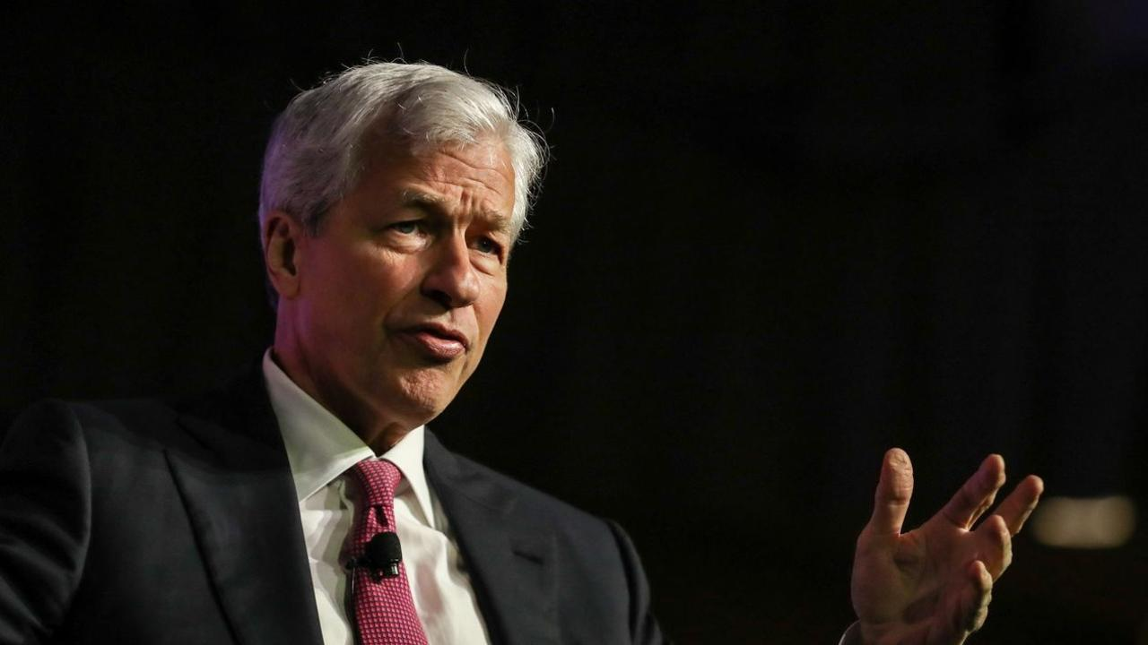
“The geopolitical situation is the thing that most concerns me,
and we don’t know the effect of that in the economy”
Jamie Dimon
JPMorgan Chase, 26.9.2023

Slide 3
Era of Globalization
Era of Geoeconomy
Assumptions
All countries follow rules and trade prevents wars
Liberalization of cross-border trade and investment
Global specialization and knowledge transfer
Trade and investment can be part of power politics
Finding a balance between security of supply and commercial interests
Fragmentation of the world economy.
Foreign Affairs’ Policy
Consequences

Slide 4
Intermediate imports from China and
the U.S. have increased (shares of all imported intermediates)
Finland
Sweden
Imports share from China
Imports share from the U.S.
Data sources: Finland: Customs, Sweden: COMTRADE, United Nations

Slide 5
Searching for import vulnerabilities
Vulnerable if 3 conditions are met
Geographical sources of vulnerable imports
Imports is concentrated
Western
bloc
(e.g. the US, EU-countries, South-Korea…)
Neutral
bloc
(e.g. India, Brazil, Equador, Ghana…)
China
bloc
(e.g. China, Russia, Indonesia…)
The share of Extra-EU imports is large
Imports can hardly be replaced by domestic ones
(Definition: see Arjona et.al., 2023)

Slide 6
A quarter of Finland's intermediate product imports are vulnerable, (6/2024)
One fifth of vulnerable intermediate product imports come from the China Bloc
24,1
20,4
%
%
Calculation: The value of imports of vulnerable intermediate products /Total imports of intermediate products
Calculation: Imports of vulnerable intermediate products’ imports from China bloc/Total imports of vulnerable intermediate products

Slide 7
Selective industrial policy has made
a comeback

Slide 8
New Justification for the Policy of Economic Affairs
Era of Globalization
Era of Geoeconomy
Prioritize policy actions that address both market failures and reduce the likelihood or impact of geoeconomic shock
Policy actions that fix market failures
Policy actions that fix market failures
Yes
Yes
Are there market failures?
Are there market failures?
Actions affecting targets with a particularly high probability of a geoeconomic shock or its significant adverse effects
No need for specific policy actions
No need for specific policy actions
No
No
No
Yes
Source: Ali-Yrkkö and Kuusi (2025). Geoeconomy changes economic policy
Are there geoeconomic risks?

Slide 9
Policy makers should take into account the risks of selective industrial policy
The announced support for Northvolt also includes up to USD 1.9 billion in capital commitments, or construction support.
PBO Canada
17/11/2023
Target industries and companies may be wrongly selected.
High propensity to the influence of interest groups, which can make the scale of subsidies too large.
Each industrial policy action must be credibly and openly justified.

Slide 10
Geoeconomic risks have become a new justification for the policy of economic affairs.
Selective industrial policy involves risks and they also apply to the most promising sectors.
Hard to see signs that geopolitical tensions will ease in the next few years.
Final Remarks

Slide 11
Appendix

Slide 12
Vulnerable imported goods, definition (Arjona et.al., 2023)
Imports is concentrated
$$HHI_M=\sum_{i=1}^{n}{(s_{i}^{2}})$$
, where $s_{i}$ is the share of exporter country i of the product’s total imports
The share of Extra-EU imports is large
$$EXT_EU=\frac{ExtraEU imports}{Total imports}$$
Imports can hardly be replaced by domestic ones
$$SUBST=\frac{Extra EU imports}{Total exports}$$
Vulnerable if s: a) Concentration (HHI_M )> 0.4)
b) More than half from outside the EU (EXT_EU > 50 %)
c) Not replaceable(SUBST > 1)

