Slide 1
Collective Bargaining in a Changing World of Work
Etla Economic Research
Helsinki, 6 October 2021
Andrea Garnero
Economist at the OECD
(currently on secondment to the
Joint Research Center of the European Commission)

Slide 2
Trade union density in Finland remains solid while it has more than halved in the OECD
% of employees who are union members, 1975-2018
Source: OECD (2019), Negotiating our way up, Paris: OECD Publishing.

Slide 3
Membership in employers’ organisations in Finland is quite strong and stable
% of employees in the private sector, 2000 or closest year and latest year available
Source: OECD (2019), Negotiating our way up, Paris: OECD Publishing.

Slide 4
Collective bargaining coverage in Finland remains very high
% of employees covered by a collective agreement, 1985-2018
Source: OECD (2019), Negotiating our way up, Paris: OECD Publishing.

Slide 5
The quality of labour relations in Finland is rather good
Co-operation in labour-employer relations as assessed by senior executives
Source: OECD (2019), Negotiating our way up, Paris: OECD Publishing.

Slide 6
Wage co-ordination plays an important role
Mode of co-ordination
State imposed / induced
Pattern bargaining
Inter/Intra-associational
Austria Denmark FINLAND Germany Japan Netherl. Norway Sweden
Austria Finland Japan Netherl. Norway Sweden Switzerland
Strong
Belgium
Degree of co-ordination
France Iceland Italy Portugal Slovenia Spain
Limited
France
Notes:
As you will see when I tell you about results, coordination turned out to be a particularly important element in differentiating between different systems leading to different outcomes.
Co-ordination is in particular an efficient tool to ensure that SP take account of the macroeconomic effects of CAs when negotiating, and ensure that they do not undermine the external competitiveness of the country and are adapted to the business-cycle situation.
So because it is an important dimension I will take a few minutes to say a few more things about the different types of coordination observed across OECD countries.
We consider both the degree of coordination (whether it is weak and peripheral, or central and well-established), and its mode.
Modes of coordination vary across OECD countries, namely it can be:
STATE-INDUCED: I.e. based on statutory controls , such as indexation rules, binding minimum wages and/or rules for maximum uprates. Depending on how many of those mechanisms exist, and how stringent they are, this mode of coordination is more or less strong. In 2015, only Belgium fell in this category of countries where coordination is strong and state induced.
PATTERN BARG: co-ordination can also take the form of the so-called pattern bargaining where a sector sets the targets first (usually the manufacturing sector exposed to international trade) and others (or at least some of them) follow. Pattern bargaining exist in Scandinavian countries, as well as in Austria, Germany and the Netherlands Japan also has a form of pattern bargaining (Shunto).
Finally, co-ordination can also take the form of intra-associational guidelines where peak level organizations set some norms or define an intra-associational objective that should be followed when bargaining at lower levels, or INTER-ASSOC. guidelines, where sectors informally consult each other to set common targets before bargaining rounds.
These various forms of co-ordination are not mutually exclusive: for instance, both pattern bargaining and guidelines can cohabit in the same country (e.g. in Norway).

Slide 7
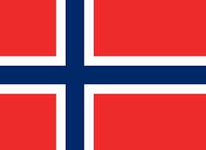
How does the Finnish system compare with the other countries?
Five main types of collective bargaining systems:
Predominantly centralised and weakly co-ordinated
Predominantly centralised and co-ordinated
Organised decentralised and co-ordinated
Largely decentralised
Fully decentralised
Notes:
So for each OECD country we used an indicator corresponding to each building block, and collected data on each dimension.
Doing this allowed us to come up with a NEW taxonomy of collective bargaining systems that classifies each OECD country over the past 40 YEARS in one of FIVE categories.
Predominantly centralised and weakly co-ordinated collective bargaining systems: Sector-level agreements play a strong role, extensions are relatively widely used, derogations from higher-level agreements are possible but usually limited or not often used, and wage co-ordination is largely absent. In 2015, France, Iceland, Italy, Portugal, Slovenia, Spain and Switzerland fell in this group.
Predominantly centralised and co-ordinated collective bargaining systems: As in the previous category, sector-level agreements play a strong role and the room for lower-level agreements to derogate from higher-level ones is quite limited. However, wage co-ordination is strong across sectors. In 2015, Belgium and Finland were part of this group.
Organised decentralised and co-ordinated collective bargaining systems: Sector-level agreements play an important role, but they also leave significant room for lower-level agreements to set the standards – either by limiting the role of extensions or allowing opt-outs. Co-ordination across sectors and bargaining units tends to be strong. In 2015, Austria, Denmark, Germany, the Netherlands, Norway and Sweden were in this group.
Largely decentralised collective bargaining systems: Firm-level bargaining is the dominant bargaining form, but sector-level bargaining (or a functional equivalent) or wage co-ordination also play a role. Extensions are very rare. Australia with its “Modern Awards” and Japan with its unique form of co-ordination (Shunto) were in this group in 2015, as well as Greece, Luxembourg and the Slovak Republic.
Fully decentralised collective bargaining systems: Bargaining is essentially confined to the firm or establishment level with no co-ordination and no (or very limited) influence by the government. In 2015, Canada, Chile, the Czech Republic, Estonia, Hungary, Korea, Latvia, Lithuania, Mexico, New Zealand, Poland, Turkey, the United Kingdom and the United States were part of this group.

Slide 8
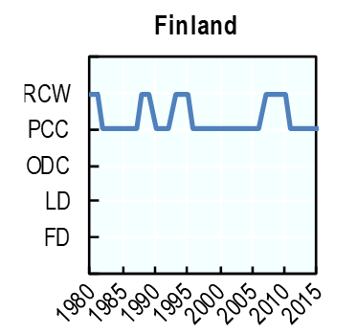
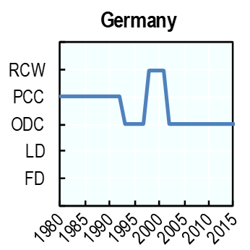
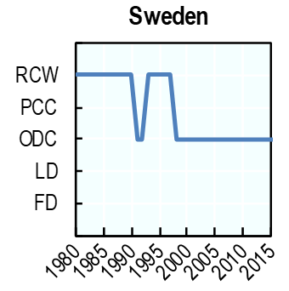
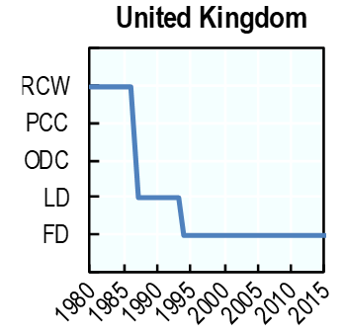
How does the Finnish system compare with the other countries?
RCW. Rather centralized and weakly coordinated
PCC. Predominantly centralized and coordinated
ODC. Organized decentralized and coordinated
LD. Largely decentralized
FD. Fully decentralized
Notes:
CENTRALISATION:
Germany: in 1993 the first hardship agreement and “restructuring clauses” were introduced in the German bargaining system;
Sweden: in 1980s central agreements played a significant a role before being rolled out;
United Kingdom: a series of reforms in the 1980s by the Thatcher government reduced the role of unions and decentralised collective bargaining first to an intermediate level (1987-1993), then to company level
COORDINATION
Finland: Several periods when co-ordination was weak.
Germany: in 1998-2001 co-ordination was weak
Sweden: in 1980-1990 and 1993-1997 co-ordination was weak

Slide 9
What is the impact of collective bargaining on labour market outcomes?
Lowest wage inequalities & level-playing field
Wage premium of firm-level bargaining
Centralisation associated with lower productivity growth
Wage co-ordination linked with ↑ employment & ↓unemployment
Wage co-ordination also increases labour market resilience
Higher quality of the work environment
Notes:
Second, when set up in the right way, CB can foster inclusive & dynamic labour markets and enhance JQ. Using the best micro- and sector-level data available, the report studies the link between CB systems and a series of LM performance outcomes. The key results are that:
CB affects wage dispersion. Wage inequalities are highest in systems with no CB or in systems with firm-level bargaining only. Wages are more equal in systems where sector-level bargaining plays a role.
At the individual level, there is a wage premium for employees who are covered by firm-level bargaining compared with those not covered or those covered only by sectoral bargaining.
Centralised bargaining systems which leave really limited little scope to firm-level are associated with lower productivity growth. This suggests that the articulation between sector & firm-level bargaining needs to be carefully fine-tuned.
More on results on productivity: based on a study of variation with +/- coverage across time (looking at effect of change in centralisation on productivity). Found that centralisation is associated with lower productivity growth; when CB more decentralised, prod growth is higher where coverage is higher.
But we need to be very prudent about these results. The literature is unclear, both theoretically and empirically, as to the direction of causality (pricing out inefficient firm and incentivising innovation and adaptation, or « hold-up » problem). There are certainly no conclusion at the aggregate level, potentially endogenous. Only suggestions more than strong results.
Co-ordinated systems – in which SP negotiating for different groups of workers follow collectively defined targets when negotiating wage increases – are linked with higher E & lower u , including for women and young people, than fully decentralised systems, in which negotiations are firm-specific and not coordinated at all.
Co-ordination also increase LM resilience. This is because it helps SP to account for the BC situation & the macroeconomic effects of wage agreements on competitiveness when negotiating.
Finally, CB also has consequences for job quality. The QWE is on average highest in countries with well-coordinated SP & a large coverage of CAs. It is also significantly higher in firms where workers can voice their concerns both through representative institutions & through channels of direct dialogue with management.

Slide 10
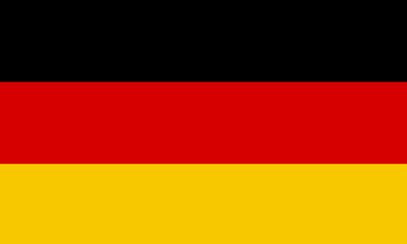
Two forms of organised decentralisation
National or sectoral agreements define the broad framework but leave large scope for setting the specific details at firm/establishment level.
National or sector agreements allow and define the conditions for deviations at lower levels via the so-called opening or opt-out clauses.
Notes:
Traxler (1995) first coined these configurations as respectively “disorganised decentralisation” and “organised decentralisation”.
Organised decentralisation (or controlled form of decentralised collective bargaining) takes two main forms in European countries (Ibsen and Keune, 2018).
In a first model, sectoral agreements provide a general framework but leave room for lower-level agreements to tailor the terms of employment. This approach is thus predicated on multi-level bargaining and strong local representation (or extensions) and can be found in Denmark, Norway and Sweden, for instance. In these countries, the favourability principle is not set in the law but entirely left to the bargaining parties who decide whether and in which case it applies. In this first form of organised decentralisation, sectoral agreements can take the following forms or a mix of them: • Minimum agreements: They set minimum standards but leave the setting of actual wages and working conditions up to company agreements, with the condition that they respect the minimum standards. • Corridor agreements: They set the boundaries (minimum and maximum) between which the terms of employment in company-level agreements can be set. • Default agreements: They set wages and working conditions, but these come only into force in case local parties do not find an agreement. Hence, company agreements can also set wages and working conditions below the default levels. • Figureless agreements: They contain no wage standards which are entirely left to the company level.
In a second model of organised decentralisation, notably present in Germany and Austria, sectoral agreements set the standard terms of employment and allow for exceptions to the favourability principle via opt-out or derogation clauses. These clauses, often also known as competition, hardship or opening clauses, allow company-level agreements to deviate downwards from wages and working conditions set in a sectoral agreement. Traditionally, such clauses were intended to apply to companies in serious economic problems for a temporary time period under predefined conditions.27 Since 2004 in Germany, opening clauses have been used more generally by companies to reduce labour costs. Some clauses allow companies to postpone or cancel parts of the sectoral agreement, notably wage increases, depending on the type or economic situation of the company.

Slide 11
How to promote wage co-ordination?
The recipe is secret but here are some of the ingredients:
Strong and representative employer and employee organisations.
A high level of trust in and between the social partners and the availability of objective and shared information on the labour market situation.
Mediation bodies to enforce pattern bargaining. With the exception of Japan, co-ordination only with some form of sectoral bargaining.
Notes:
A precondition for a well-functioning co-ordination of wage bargaining is to have strong and representative employer and employee organisations.
Wage co-ordination requires a high level of trust in and between the social partners and the availability of objective and shared information on the labour market situation.
Enforcing maximum wage targets is not straightforward, especially if some non-tradable sectors can afford more than the agreed “cost mark”. Ibsen (2016) highlights the role of mediation bodies for the functioning of pattern bargaining in Denmark and Sweden. In Denmark, the mediation institution can call for the approval of all agreements into one majoritarian union ballot, which effectively forces potential defectors into the agreement. In Sweden, the mediation process works rather through persuasion and naming and shaming. Conversely, the lack of effective mediation bodies is considered as one of the reasons behind the decline of pattern bargaining in Germany.

Slide 12
Thank you
Andrea Garnero (andrea.garnero@ec.europa.eu)
Twitter: @AGarnero

Slide 13
ADDITIONAL SLIDES

Slide 14
Youth do not appear to be turning their nose up to unions
% of employees who are union members, 1975-2018
Source: OECD (2019), Negotiating our way up, Paris: OECD Publishing.

Slide 15
Unions appear to be able to include non-standard workers too
Estimated trade union density for standard and non-standard workers (% of employees, latest year available)
Actual ratio (↗)
Ratio adjusted for individual characteristics
Source: OECD (2019), Negotiating our way up, Paris: OECD Publishing.

Slide 16
Industrial disputes have been decreasing
Co-operation in labour-employer relations as assessed by senior executives
Source: OECD (2019), Negotiating our way up, Paris: OECD Publishing.

